Slide 1
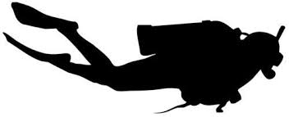
Start
Fish data collection : 5 transects 30m x 2m
(species, size, number)
End
Benthic cover data collection : seafloor pictures every 2m on the 5 transects
Macroinvertebrate data collection : 10 first meters of the 3 first transects (species, number)
Algae & Coral recruit data collection : quadrat every 2m of the macroinvertebrate transects
(Algae and turf heigh, coral recruit species and size)

Slide 2
